Slide 1

P-379 Customer personality analysis
Group Members :
Mr. VAMSHI KRISHNA K
Mr. JAY CHANDRAVADAN TRIVEDI
MR.KRISH SANDIPKUMAR MODI
MR.SANGAMESH G SHEELAVANTHMATH
MRS. YOGITA AMIT SHINDE
MS. POOJA DATTATRAY TEMGIRE
MRS. JAZEENA A

Slide 2
Contents
Project Architecture
Introduction
Data set Details
Data preprocessing and EDA
Visualization
Model Building
Deployment
Challenges Faced
Conclusion and Improvements
Reference

Slide 3
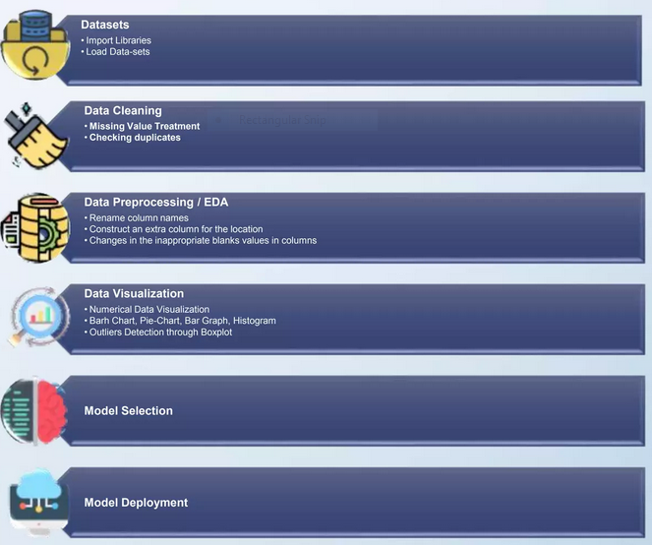
1. Project Architecture

Slide 4


2. Introduction
Customer personality analysis helps a business to modify its product based on its target customers from different types of customer segments.
For example, instead of spending money to market a new product to every customer in the company's database, a company can analyze which customer segment is most likely to buy the product and then market the product only on that particular segment.

Slide 5
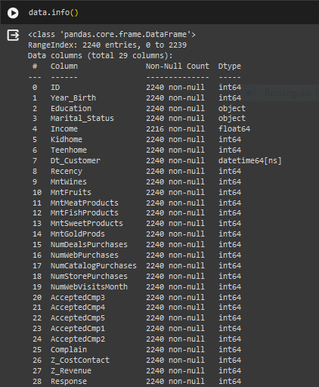
3. Dataset Details

Slide 6
4.Data Preprocessing and EDA
2240
2240
In Dataset
Checking of null values and missing data and replaced by mean value.
Checking of duplicated values- No duplicate values.
Removing columns Z_CostContact" and "Z_Revenue“,It have same value in all the rows.
Removing outliers in income column.
Combining different dataframe into a single column to reduce the number of dimension.
Converting the Year_Birth to customer_Age.
Removing outliers in customer_Age column.

Slide 7
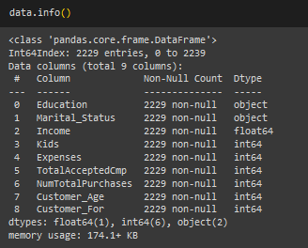
After applying preprocessing on all three dataset This is the dataset we got after EDA processing.

Slide 8
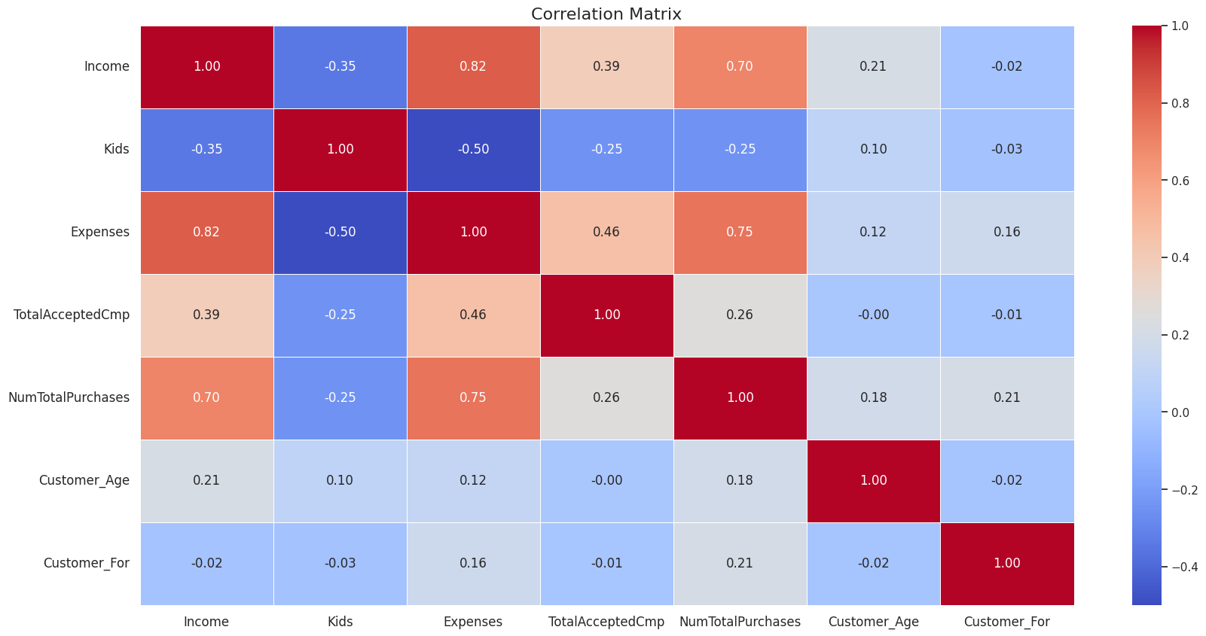
5.Visualization
Correlation matrix
Income is more positively correlated to Expenses and Number of purchases
Expenses is positively correlated to Income and Number of purchases and negitively correlated with Kids

Slide 9
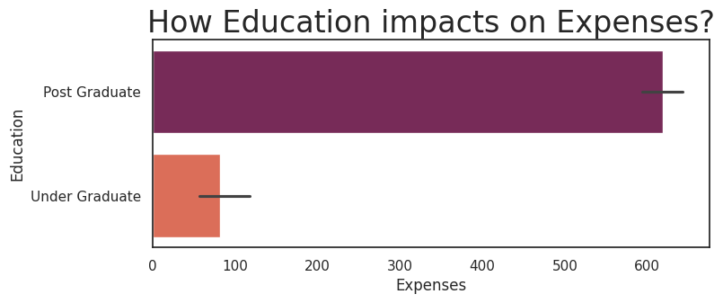
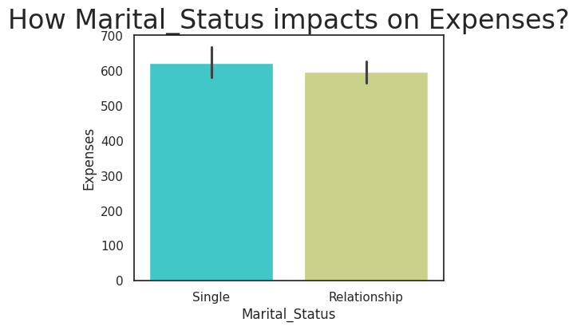
Education vs Expenses
We observe that the post graduated people spends more than the UG people
Marital Status vs expenses
Single customers spend more as compared with Relationship customer

Slide 10
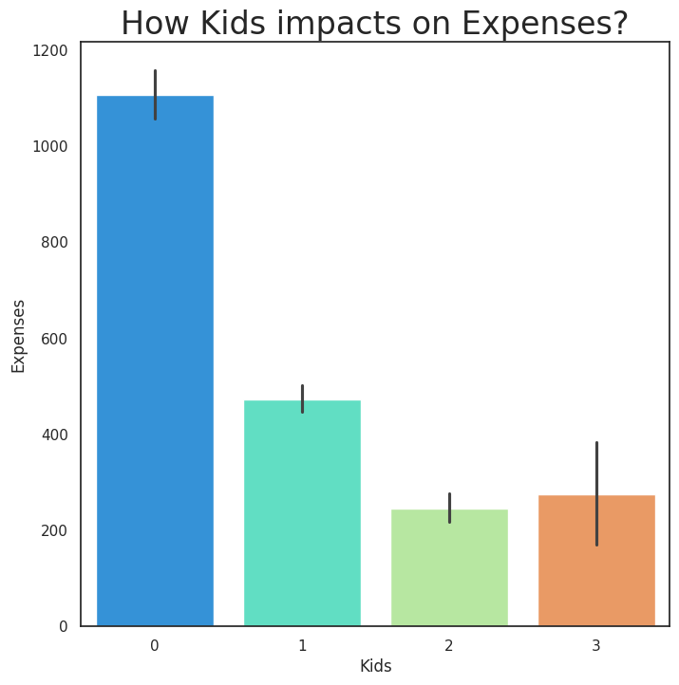
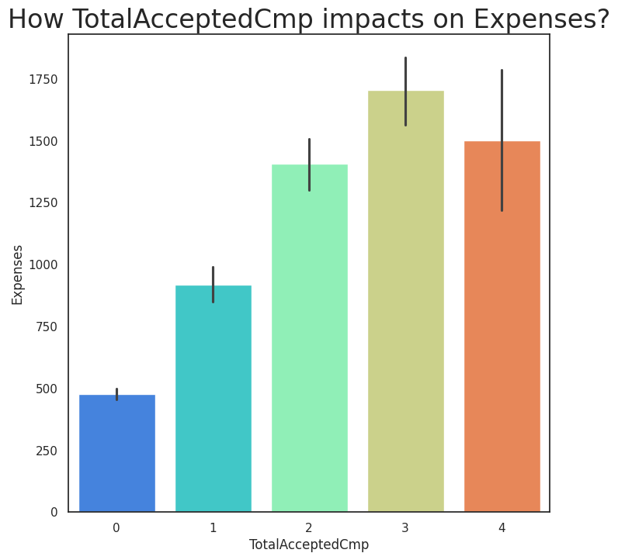
Kids vs Expenses
Here we observe some thing different that parents with 0 kid spends more than the parents who are having 2 or 3 kids
TotalAcceptedCmp vs Expenses
Those who accepeted more campaign have more expenses
TotalAcceptedCmp : Total Number of customer accepted the offer in each campaign 1 to 5

Slide 11
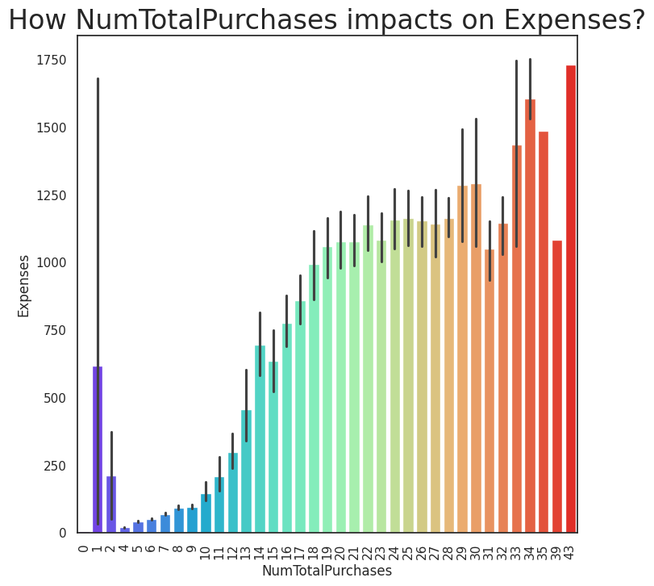
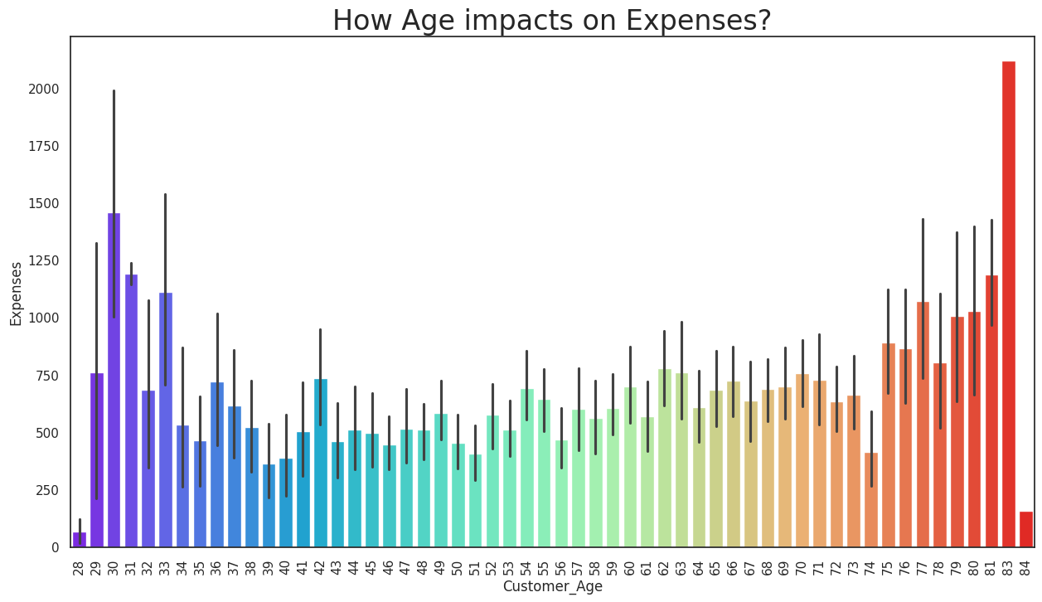
NumTotalPurchases vs Expenses
Those who have more purchases have more expenses.
NumTotalPurchases: Number of purchases made through Website, catalogue, store
Customer Age vs Expenses
People who are in middle age have less expenses than others

Slide 12
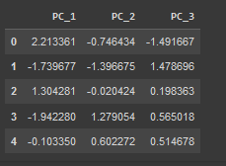
Label encoding, standardizing and Dimensionality reduction
Label encoding daone by two columns such as Education and Marital status.
Standard scaling is done by other columns
Principle Component Analisis: It will help us to minimize the information loss and increase the possibility of data to be interpreted better. Before start, the amount of principal vectors should be chosen

Slide 13
6.Model Building: CLUSTERING
Clustering is used to identify groups of similar objects in datasets with two or more variable quantities.
Clustering methods, such as Agglomerative , k means, DB Scan clusters. These techniques use various methods to determine the appropriate result for the problem. Clusters are loosely defined as groups of data objects that are more similar to other objects in their cluster than they are to data objects in other clusters.

Slide 14



Clustering
In K Means
In Agglomerative Clustering
In DBScan
Comparing silhouette_score then chosen
kmeans and finalizing clusters as 5

Slide 15
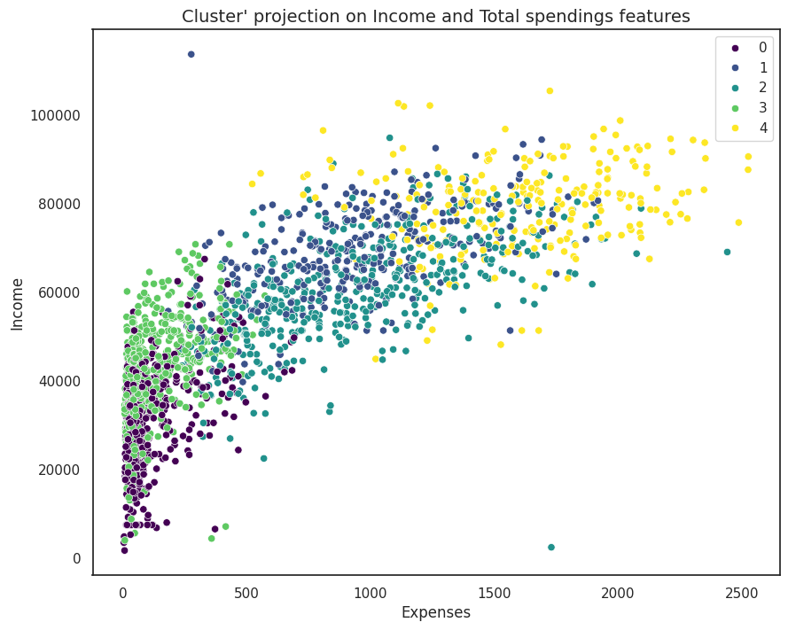
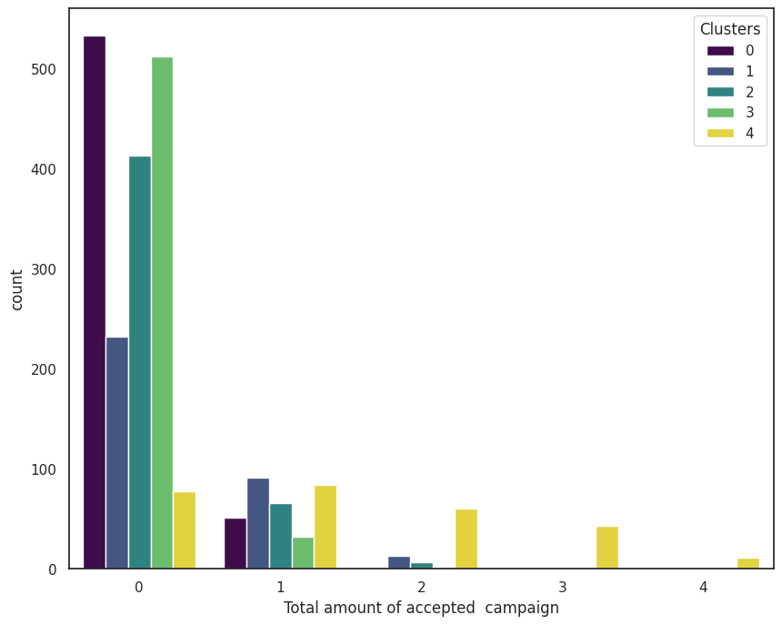
Clustering
Cluster projection on Income and Total spendings features
Cluster 0: average spendings and average income Cluster 1: low spendings and average income
Cluster 2: high spendings and high income
Clustrer3: avg spending and high income
Cluster 4: low spendings and low income
Total accepted campaign distribution across clusters
As we can see, there is a very little response from the customers to the marketing campaign

Slide 16
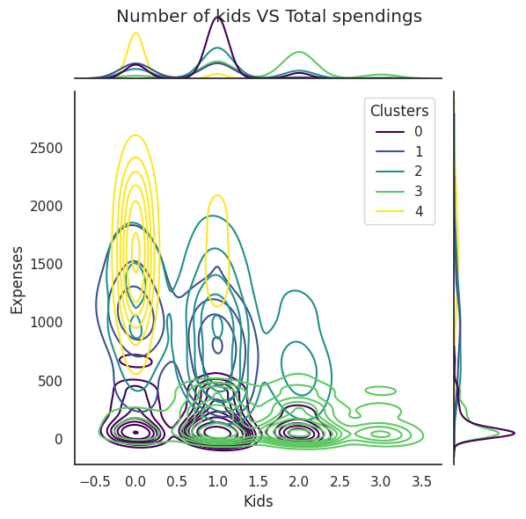
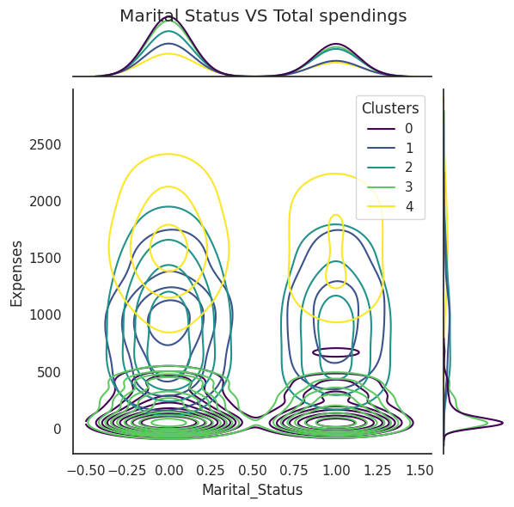
Clustering
Distribution of clusters : no. of kids vs Spendings
Cluster 0: Certainly parents cluster having mostly 1
Cluster 1: having 1 to 3 kids
Cluster 2: having almost no kids
Cluster 3: having no kid almost
Cluster 4: having 1 kid mostly
Distribution of clusters : Marital Status vs Spendings
0 cluster married
1 cluster majority of them are married(but the size of groups are nearly equal)
2 cluster having partner
3 both married and single are almost same
4 cluster single

Slide 17
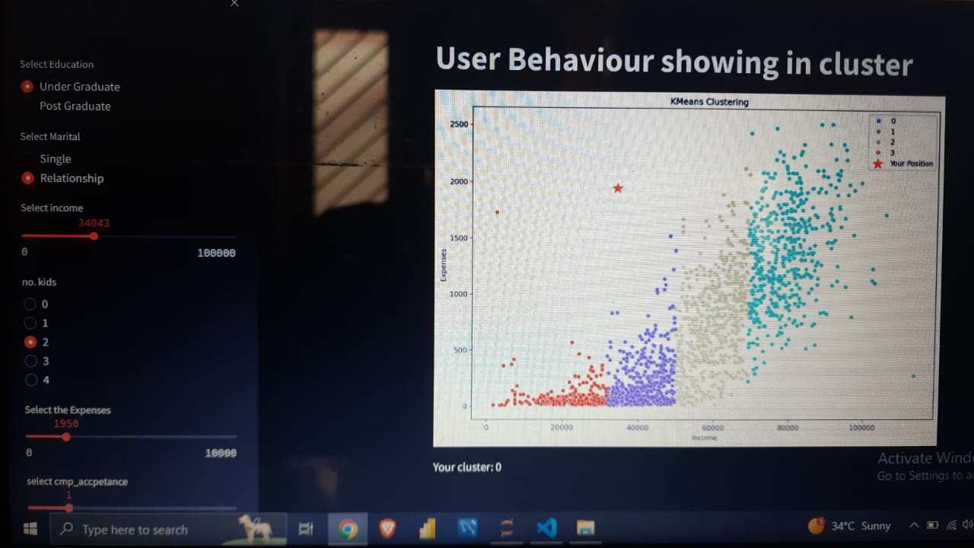
7.Deployment

Slide 18
8.Challenges Faced
Dimensionality Reduction
Eliminating Outlier
CHALLENGES
Model Building
Increasing Model accuracy

Slide 19
9.Conclusion and Improvements
It can be inferred that Kmeans algoritham provides the best result in terms of Customer personal analysis.
Outliers in the data have been removed better accuracy and better clustering result.
Dimensionality reduction done using PCA for increasing accuracy of the result
The above improvements have helped in getting a good accuracy for the final model.

Slide 20
10.References
Pandas documentation link:- https://pandas.pydata.org/docs/getting started/index.html
Matplotlib documentation:- https://matplotlib.org/stable/index.html
Visual studio code :- https://code.visualstudio.com/learn
Cluster documentation:-https://www.geeksforgeeks.org/clustering-in-machine-learning/

Slide 21
THANK YOU

